Slide 1
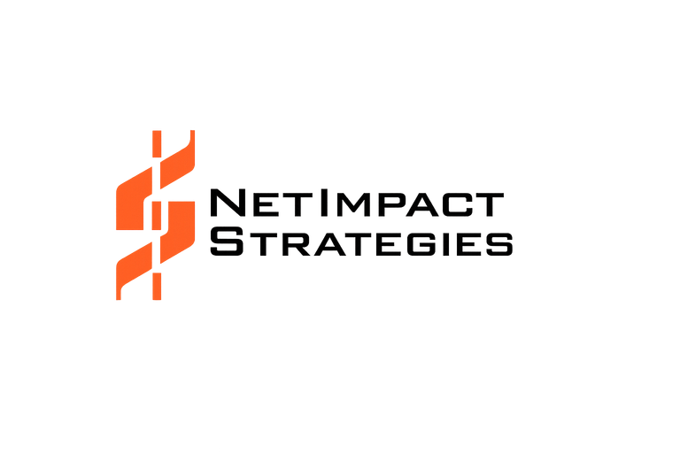
AIFORGE
TM
AI-Driven Intelligent Modernization Platform
Transform Legacy Applications into Intelligent Enterprise Solutions
Modernize enterprise software through AI-driven analysis, intelligent automation,
enterprise governance and secure cloud-ready delivery.
AI Powered
Enterprise Ready
Human Governed
Cloud Native
Secure
Future Ready
From Legacy Complexity to Intelligent Modernization
Powered by AIForge™ AI-Driven Intelligent Modernization Platform
Copyright © NetImpact Strategies Enterprise AI Modernization 2026. All Rights Reserved.

Slide 2
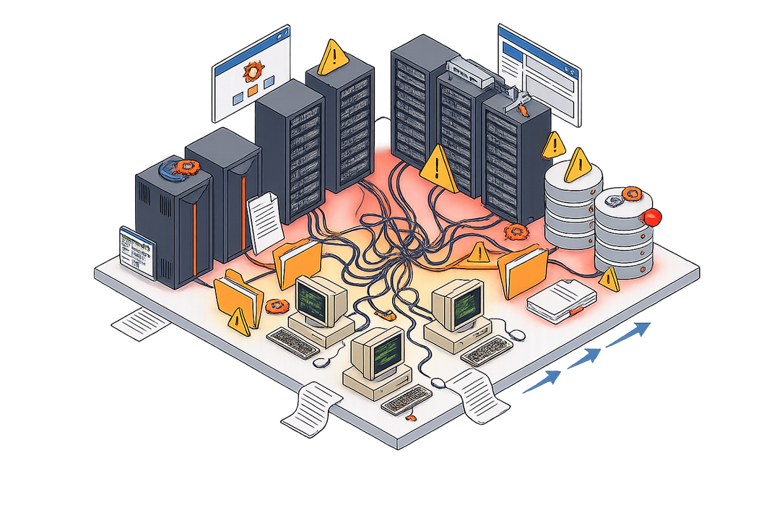
AIFORGE
TM
AI-Driven Intelligent Modernization Platform
Legacy Enterprise Challenges
Legacy Enterprise Reality
Disconnected legacy applications increase technical debt, security risks and operational complexity, slowing enterprise innovation.
25+ Legacy Technologies
Decades of Technical Debt
Fragmented Documentation
COBOL
.NET
PowerBuilder
ColdFusion
Technical Debt
Retiring SMEs
Limited Documentation
Java
Years of accumulated complexity.
Critical knowledge leaving the workforce.
Application knowledge is fragmented.
Mainframe
Oracle Forms
C++
Slow Delivery
High Modernization Cost
Security Risks
Long release cycles reduce agility.
Requires significant investment.
Legacy platforms increase operational risk.
Commercial | Government | Healthcare
Banking | Public Sector | Manufacturing
Copyright © NetImpact Strategies Enterprise AI Modernization 2026. All Rights Reserved.

Slide 3
AIFORGE
TM
AI-Driven Intelligent Modernization Platform
AI-Driven Intelligent Modernization Engine
AI-powered software modernization across the complete software development lifecycle.
Why AIForge™
  Containerized Platform
  Human-in-the-loop AI
  No Vendor Lock-in
  Maintainable Production Code
  Reusable AI Knowledge
  Enterprise-grade Security
Modernization Lifecycle
Legacy Inputs
Modern Outputs
COBOL
Legacy Code Ingestion Automatically understands 25+ legacy technologies
Business Logic Extraction Discovers workflows, dependencies and architecture
Cloud Native Application
Java
AIForge™
REST APIs
.NET
Deployment
Deploys production-ready applications into secure enterprise cloud environments
Deployment Agent
Intelligent Modernization Engine
Architecture Agent
AI Knowledge Graph
Create a complex detailed actual node graph blueprint connecting applications, data and business logic, not just an icon
Documentation
PowerBuilder
Automated Tests
Secure Cloud
Deploys-ready applications into-secure enterprise cloud environments
AI Software Factory
Generates modern applications, APIs, documentation, testing and deployment assets
ColdFusion
CI/CD Pipeline
Migration Agent
Oracle Forms
Why AIForge™
Documentation Agent
Modern UI
  Containerized Platform
  Human-in-the-loop AI
  No Vendor Lock-in
  Maintainable Production Code
  Reusable AI Knowledge
  Enterprise-grade Security
Security Agent
Mainframe
Human Governance
Human approvals, explainability, compliance and auditability
Production Ready
Copyright © NetImpact Strategies Enterprise AI Modernization 2026. All Rights Reserved.

Slide 4
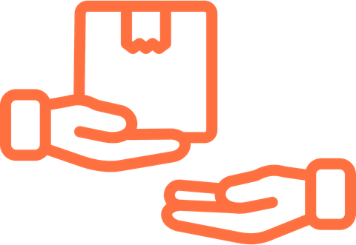
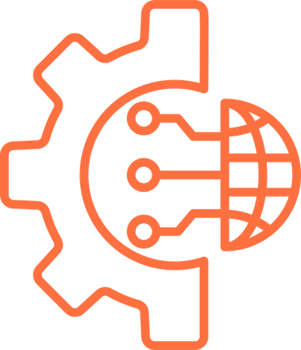
AIFORGE
TM
AI-Driven Intelligent Modernization Platform
The Need for Intelligent Modernization
Modern enterprise transformation requires more than code migration.
Organizations need intelligent analysis, automation, and governance to modernize successfully.
Traditional Modernization Challenges
Why Intelligent Modernization Matters
Legacy Enterprise
Manual Code Analysis
Knowledge Dependency
Understand Business Logic
Reveal Hidden Dependencies
Business Logic
Requires significant engineering effort.
Critical business logic exists only in SME knowledge.
Dependencies
Automatically discover application behaviour.
Map relationships across systems.
Architecture
Fragmented Documentation
Complex Dependencies
Reduce Manual Effort
Improve Delivery Confidence
Knowledge
Incomplete or outdated system documentation.
Applications, databases, and integrations are tightly coupled.
Automate repetitive modernization activities.
Support governance through transparency.
Disconnected Systems
Complex Integrations
Slow Modernization
High
Project Risk
Accelerate Decision Making
Prepare for Cloud Transformation
Traditional approaches take months or years.
Unexpected complexity increases delivery risk.
Hidden Relationships
Technical Debt
Provide better modernization insights.
Create a foundation for cloud-native modernization.
Traditional Modernization I Intelligent Modernization I AI-Driven Modernization
Copyright © NetImpact Strategies Enterprise AI Modernization 2026. All Rights Reserved.

Slide 5
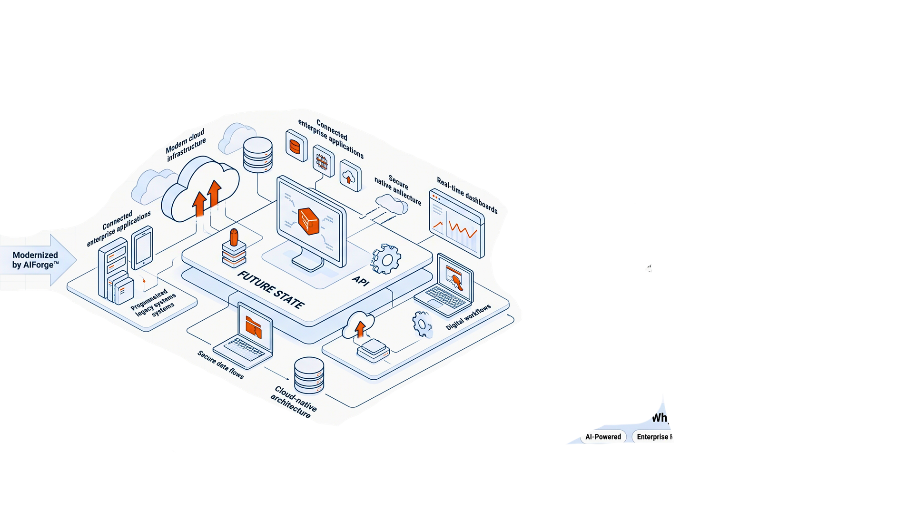
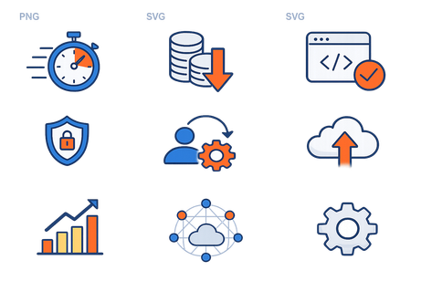
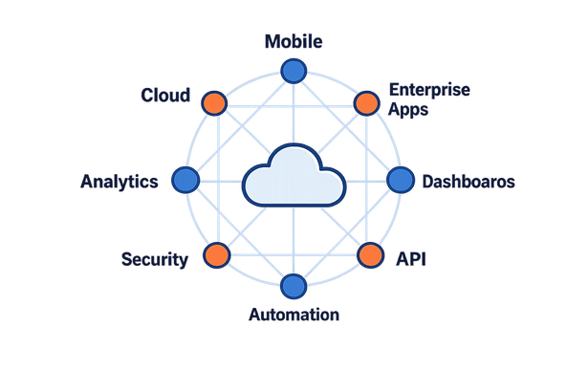
AIFORGE
TM
AI-Driven Intelligent Modernization Platform
Business Outcomes
Enterprise Value Delivered with AIForge™
Accelerate modernization, reduce risk and deliver secure, production-ready applications.
Up to
90% Faster
Up to 10× Lower Cost
Production-Ready Applications
Accelerate application modernization using AI-driven automation.
Reduce migration effort through intelligent automation.
Deliver secure, maintainable software without extensive manual redevelopment.
Secure by Design
Human-in-the-Loop
Cloud Native
Support enterprise governance with secure deployment and compliance.
Maintain transparency through approvals, review and explainability.
Deploy scalable enterprise applications across modern cloud environments.
Business Impact
Minimisist in design, visualising four measurable enterprise outcomes
  Innovation
  Operational Efficiency
  Delivery Speed
  Business Agility
Copyright © NetImpact Strategies Enterprise AI Modernization 2026. All Rights Reserved.

Slide 6
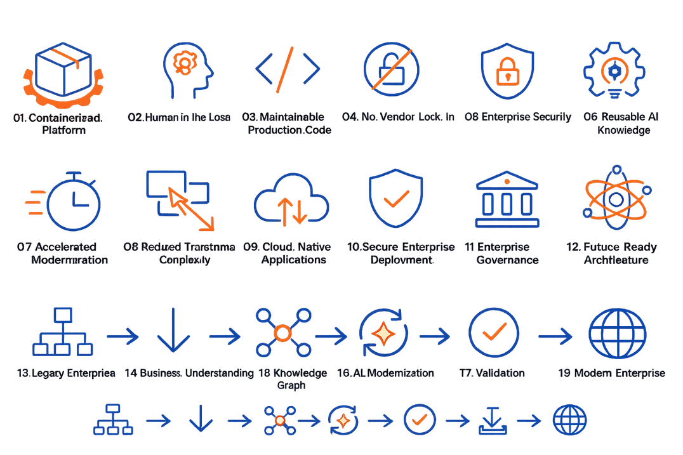
AIFORGE
TM
AI-Driven Intelligent Modernization Platform
AI-Driven Intelligent Modernization Platform
Modernizing enterprise applications with AI, automation and governance.
Why Enterprises Choose AIForge™
Cloud
Containerized Platform
Human-in-the-Loop AI
Accelerated Modernization
Reduced Transformation Complexity
Enterprise Applications
Automation
Analytics
Knowledge Graph
Human Governance
Cloud-Native Applications
Secure Enterprise Deployment
Maintainable Production Code
No Vendor Lock-In
API Services
AI Orchestration
Security
Enterprise Governance
Future-Ready Architecture
Enterprise Security
Reusable AI Knowledge
AIForge enables organizations to modernize complex legacy software by combining AI-driven analysis, intelligent automation and enterprise governance into one secure modernization platform.
Legacy Enterprise
AI Understanding
Knowledge Graph
Modernization
Validation
Deployment
Modern Enterprise
Copyright © NetImpact Strategies Enterprise AI Modernization 2026. All Rights Reserved.

Slide 7
AIFORGE
TM
AI-Driven Intelligent Modernization Platform
Ready to Modernize? Transform Legacy
Systems into Intelligent Enterprise Applications
Modernization isn’t about replacing software. It’s about preserving business knowledge while accelerating innovation through AI.
Contact Us (703) 559-3280
Follow Us
Powered by AIForge™ AI-Driven Intelligent Modernization Platform
Copyright © NetImpact Strategies Enterprise AI Modernization 2026. All Rights Reserved.

